Slide 1

Project D
Cybersecurity Professional
Marc Pierrot
lmpierrot1@gmal.com
(954)589-8027

Slide 2
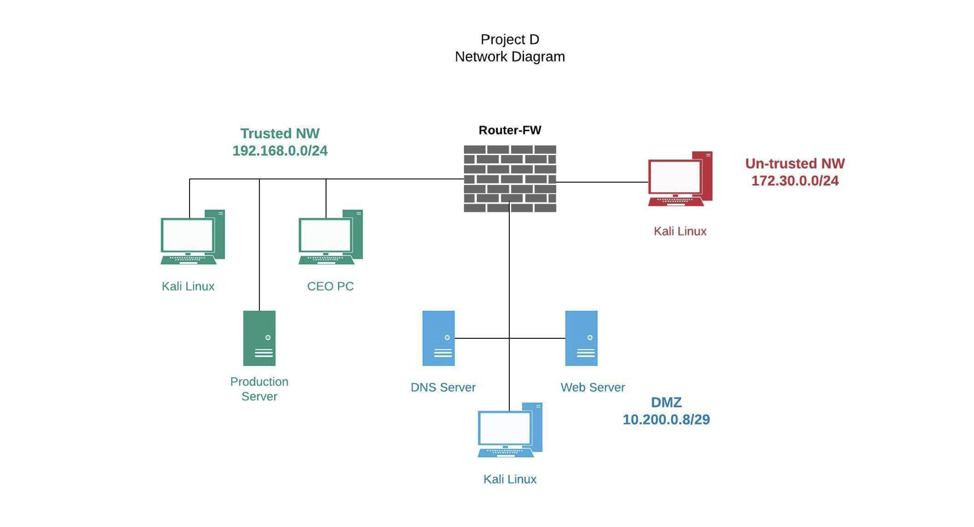

Slide 3
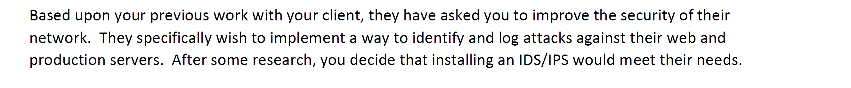
Scenario

Slide 4
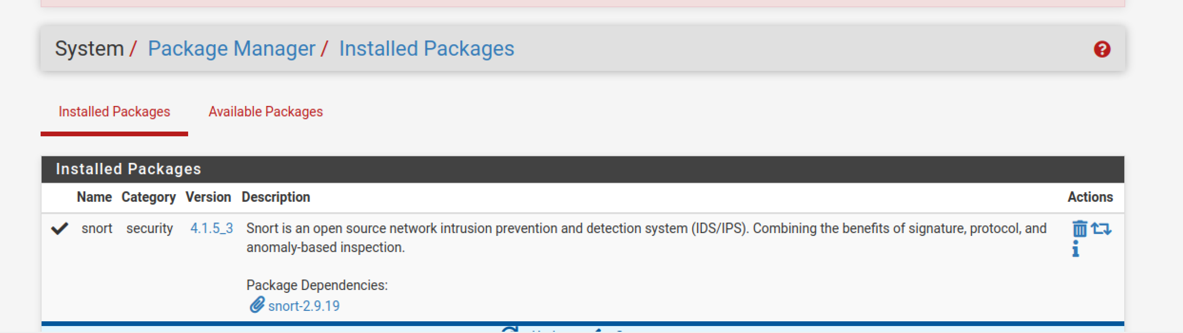
Snort Installed

Slide 5
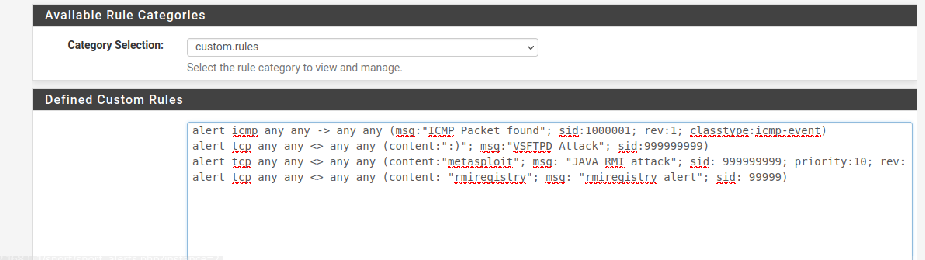
Alert Rules

Slide 6
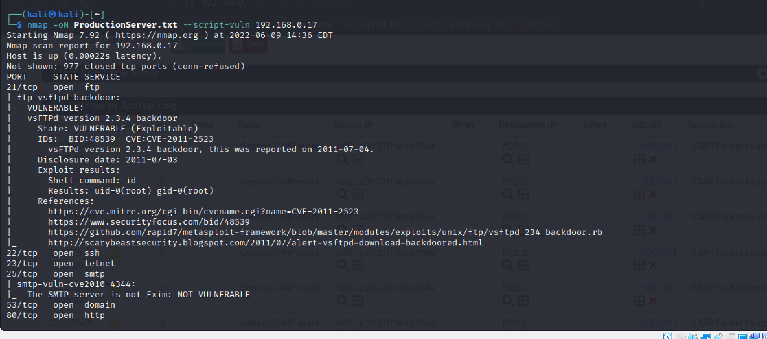
Scan

Slide 7
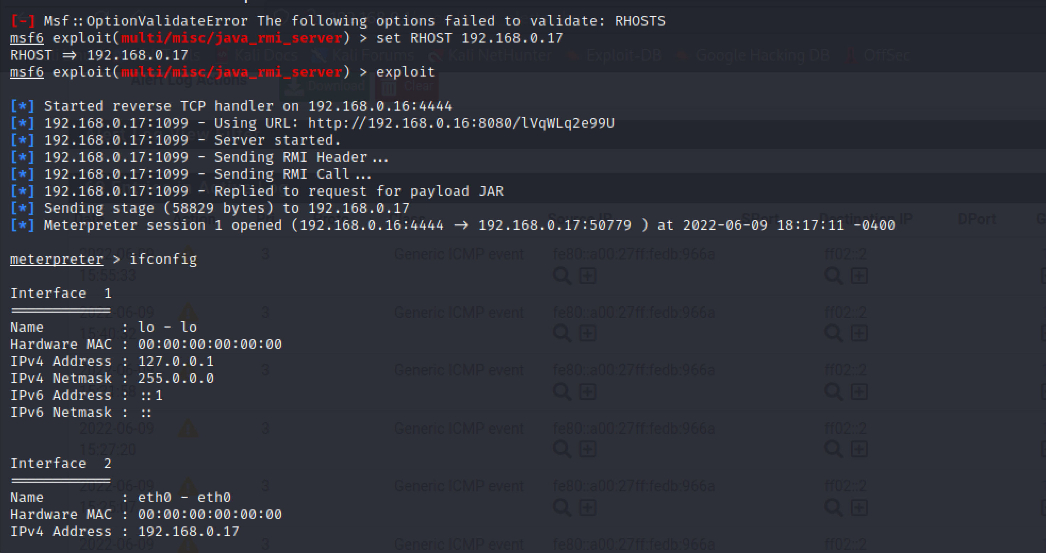
Exploitation

Slide 8
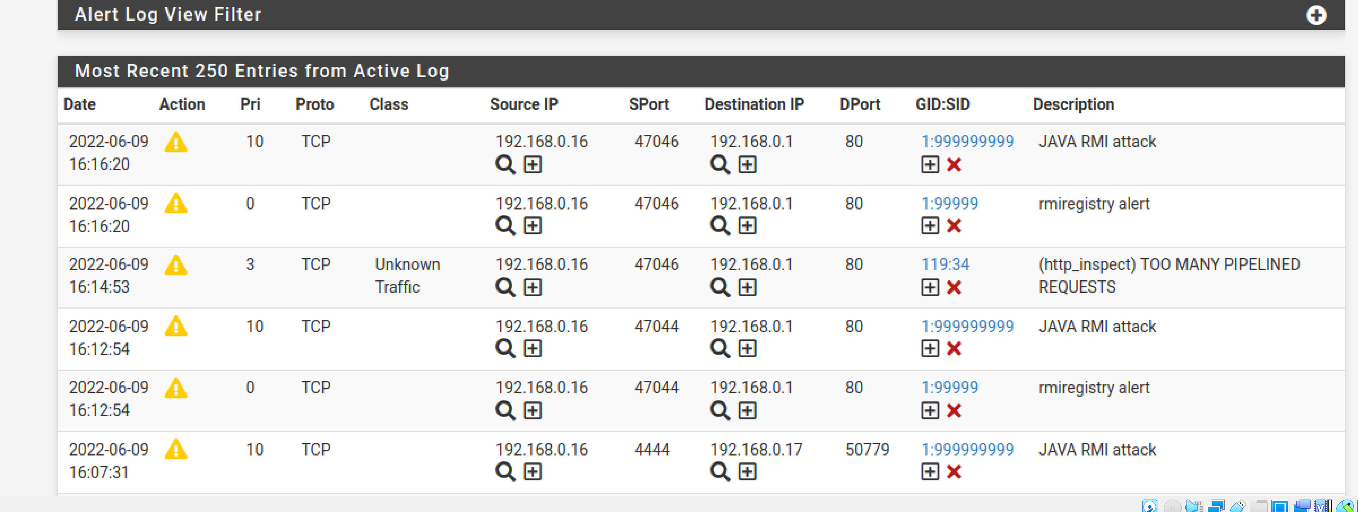
Example of alert 1

Slide 9
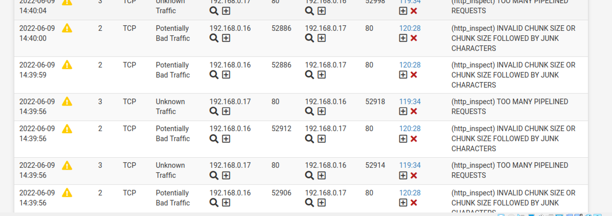
Example of alert 2

Slide 10
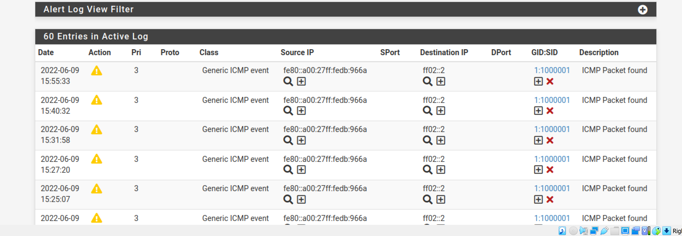
Example of alert 3

Slide 11
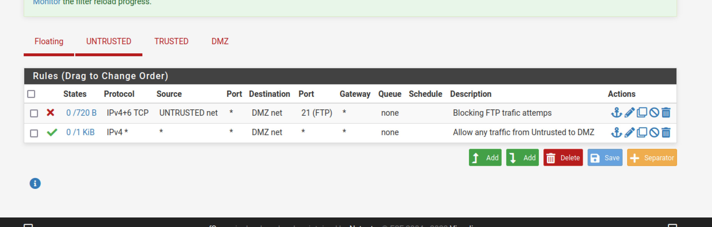
FTP Traffic

Slide 12

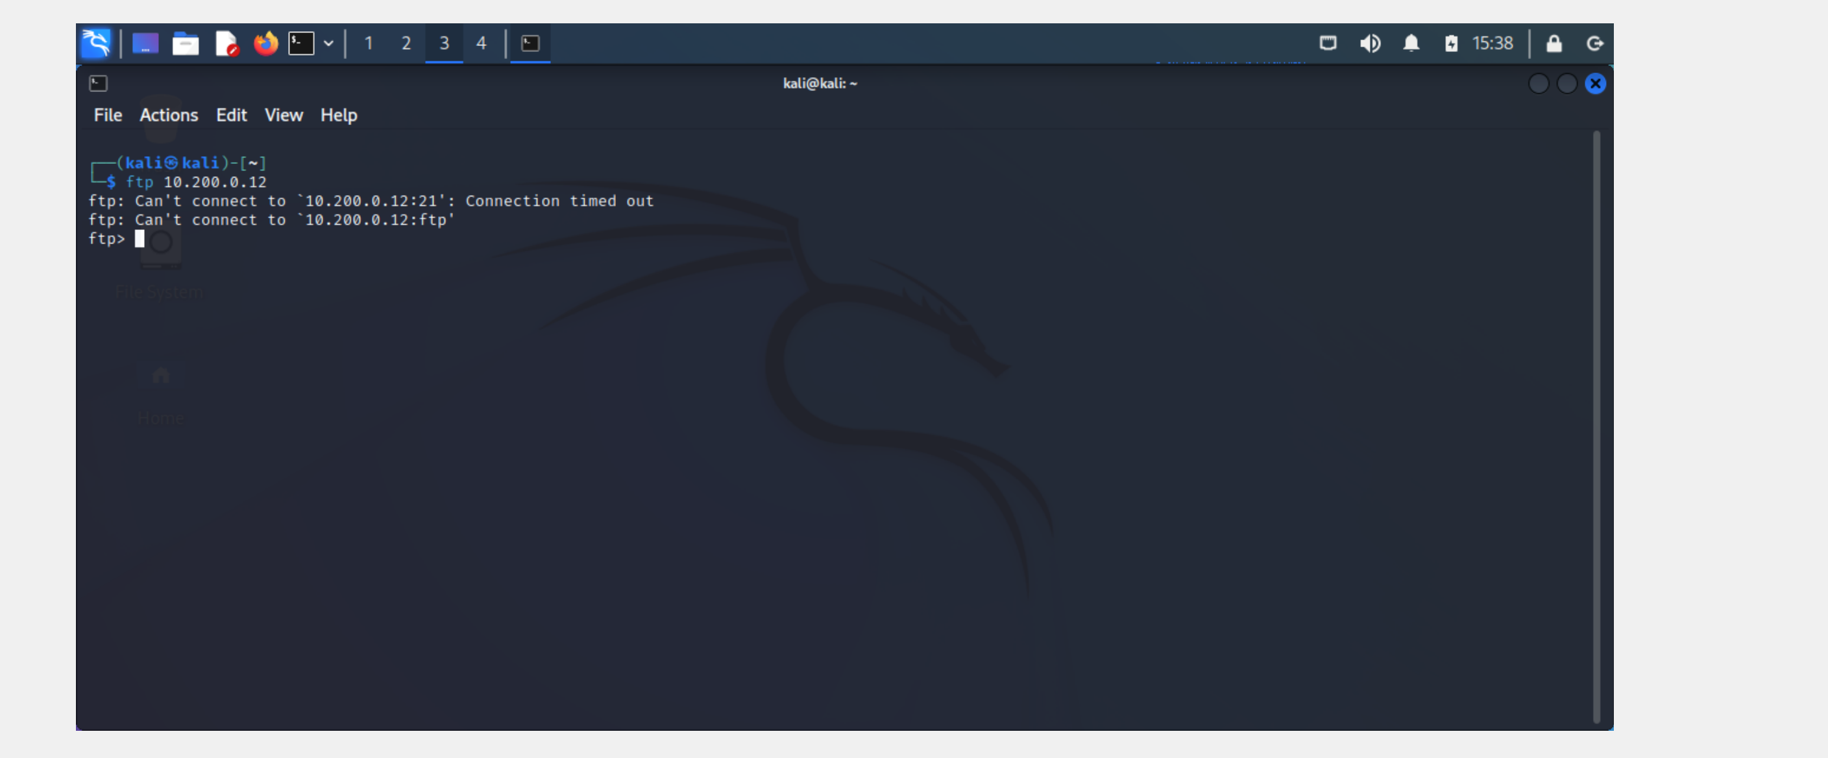
FTP Traffic blocked

Slide 13
Recommendation
1- The DMZ and Trusted networks are crucial to an organization's security. Improving their security will have a direct influence on the organization's overall security. It's critical to keep the DMZ's software and systems up to date with the most recent security fixes
2- Restrict access to any port and any website that we don’t want our employees to have access to.
3- Monitoring the IPS/IDS installed for any alarm while trying to improve it to be better

Slide 14

END

